Slide 1
How to make a video

Slide 2
How to record screen
There are many programs, but one that is free and you can use in different computer is :
https://icecreamapps.com/Screen-Recorder/
Download, and record your screen. (easy to use)

Slide 3
HOW TO DOWNLOAD VIDEOS FROM YOUTUBE
There are many programs, one that is free and easy to use:
https://yt1s.com/en6
Copy the youtube website and download as mp4 file.

Slide 4
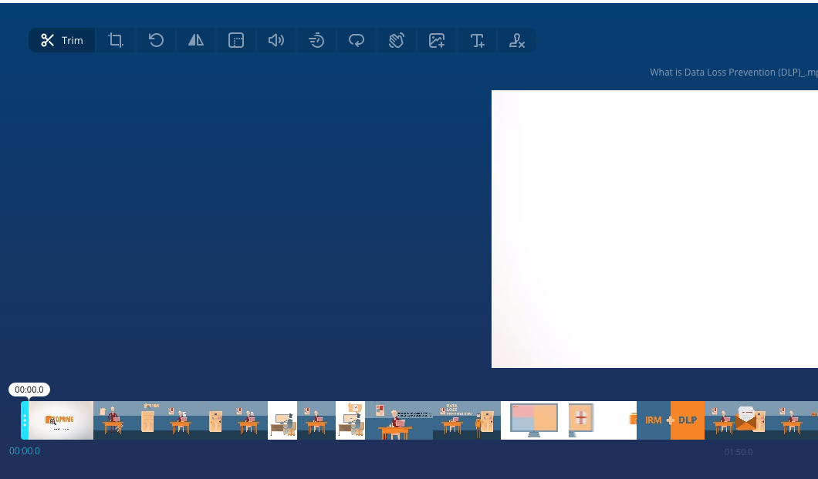
How to cut a video
https://online-video-cutter.com/
Select the section you want
Then, you can upload it in your spark video.

